Slide 1

Dept. of Computer Science & Engineering
Project Title:Arduino Based Autonomous Smart Floor Mopping Robot
Presented by
Kamrul Hasan
Id: 151382010
Md.Saidul Islam Bhuiyan
Id: 151382047
Supervised by
Sifatul Mostafi
Lecturer,
Department of CSE
City University

Slide 2
Outline:
Introduction
Aim of project
Methodology
Tools
Language
Advantage
Future work
Conclusion
Reference
Arduino Based Autonomous Smart Floor Moping Robot

Slide 3
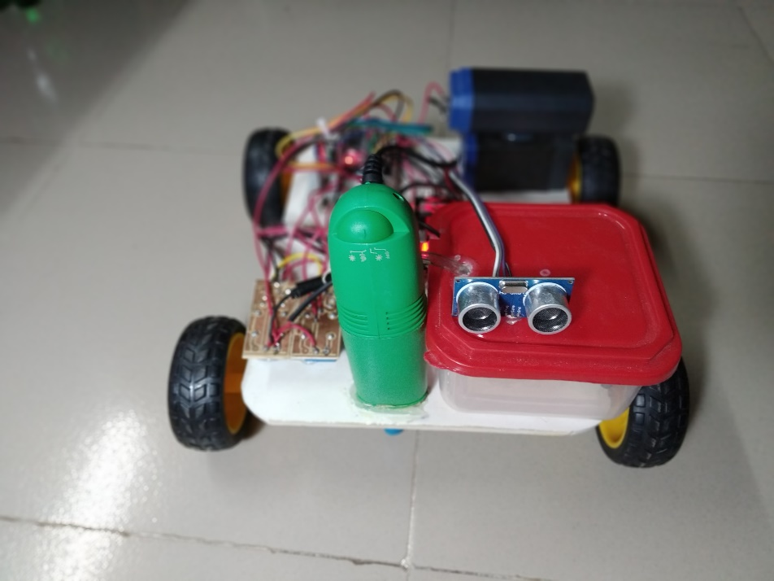
Introduction
Households of today are becoming smarter and more automated.
In this project we introduce the automatic floor mopping robot for mopping floor.
Automatic floor mopping will reduce the effort required for mopping floor in the law.
Arduino Nano microcontroller is utilized as the microcontroller.
Every action of the floor mopper is monitored by the microcontroller with the help of the android apps.
Arduino Based Autonomous Smart Floor Moping Robot

Slide 4
Aim of Our Project
More appropriate.
Easy to use.
Physical work escape.
Electric Rechargeable.
Subsidy.
Arduino Based Autonomous Smart Floor Moping Robot

Slide 5
Tools
Robotics chassis
Arduino Nano R3
HC 05 Bluetooth module
Battery 11 volt.
Gear motor driver
L298D motor driver
Relay Module
Jumper wires
Brush
Servo Motor
Water Pump
Water jar
Ultrasonic Sensors
Vacuum
Arduino Based Autonomous Smart Floor Moping Robot

Slide 6
Languages
Arduino Programming Language
C++
Arduino Based Autonomous Smart Floor Moping Robot
21/11/2019

Slide 7
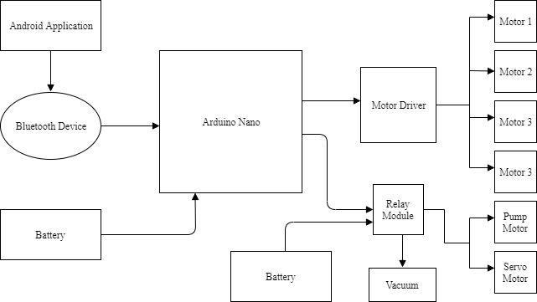
Methodology
Figure 1: Block Diagram of Arduino Based Autonomous Smart Floor Moping Robot
Arduino Based Autonomous Smart Floor Moping Robot

Slide 8
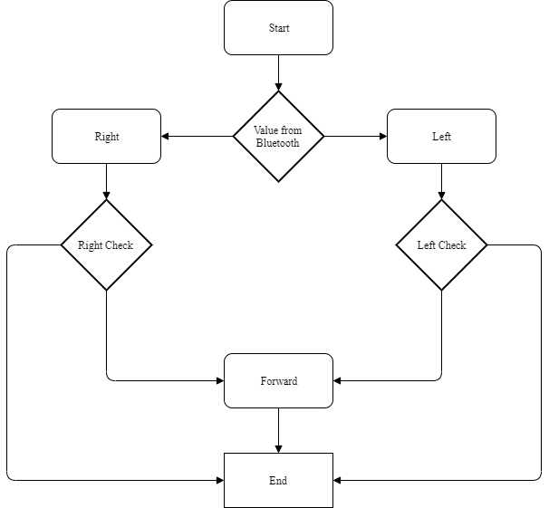
Methodology Cont.
Figure 2: Flowchart Diagram of Arduino Based Autonomous Smart Floor Moping Robot
Arduino Based Autonomous Smart Floor Moping Robot

Slide 9
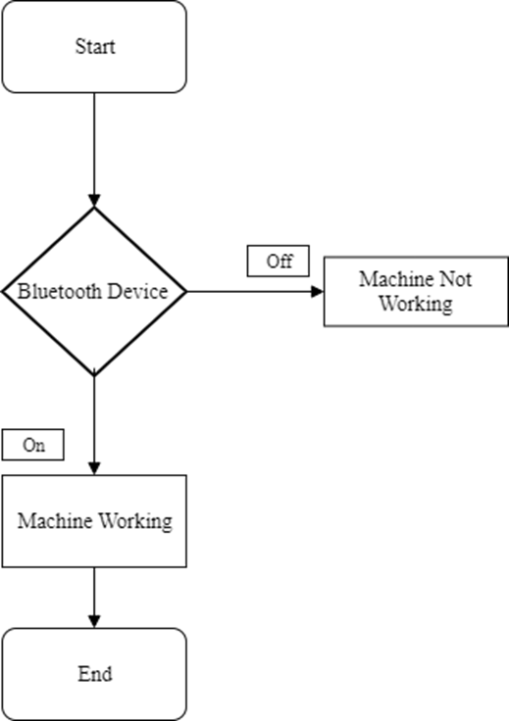
Methodology cont.
Figure 3: Connection Application of Autonomous Smart Floor Moping Robot
Arduino Based Autonomous Smart Floor Moping Robot

Slide 10
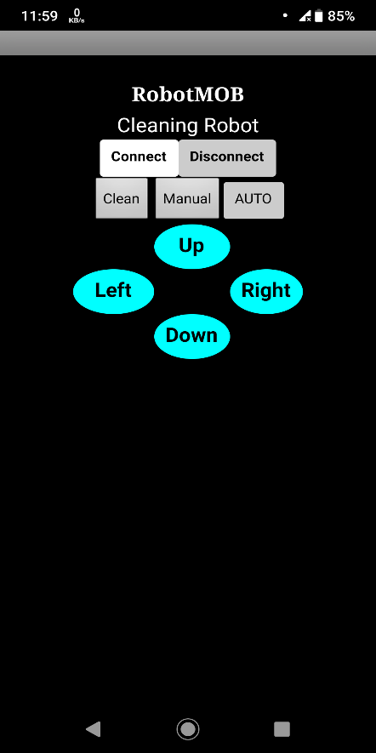
Methodology cont.
Figure 4: Application view of Arduino Based Autonomous Smart Floor Moping Robot
Arduino Based Autonomous Smart Floor Moping Robot

Slide 11
Advantage
This machine size small and portable.
This project can used by anyone without previous experience. And interesting as he controls the car remotely. And it’s uses automatically and manually.
Controlled by Mobile apps
Mostly gather electronic power to Battery, That’s why it’s needed to charge directly from electric.
No fuel needed.
No pollution.
Arduino Based Autonomous Smart Floor Moping Robot

Slide 12
Risk Factor
Failure of the proposed circuit.
Faulty system components.
Failure of synchronization between the working circuit and mechanical structure.
Failure of power supply.
Arduino Based Autonomous Smart Floor Moping Robot

Slide 13
Future work
LED light Can be Used for Night Vision.
Automatic Moisture Detection that is Displayed on the LED Display.
Automatic Alart System for Moving Obstacles.
Arduino Based Autonomous Smart Floor Moping Robot

Slide 14
Conclusion
Our project is more appropriate for a common man as it is having much more advantages.
This provides more physical work escape to the people and can be easily handled. This system is having ability of charging battery from electricity.
This Robot can be operated in night time also
Arduino Based Autonomous Smart Floor Moping Robot

Slide 15
References
[1] IEEE Standard for User Interface Elements in Power Control of Electronic Devices employed in Office/Consumer Environments, IEEE Standard 1621,2004(R2009).
[2] Harvey Koselka, Bret A. Wallach, David Gollaher,“Autonomous floor mopping apparatus,” U.S. Patent 6741054 B2, May 25, 2004.
[3] Joseph L. Jones, Newton E. Mack, David M. Nugent, Paul E. Sandin, “Autonomous floor-cleaning robot,” U.S. Patent 6883201 B2, April 6, 2005.
[4] Andrew Ziegler, Duane Gilbert, Christopher John Morse, Scott Pratt, Paul Sandin, Nancy Dussault, Andrew Jones, “Autonomous surface cleaning robot for wet and dry cleaning,” U.S. Patent 7389156 B2, June 17, 2008.
[5] Shih-Che HUNG, Yao-Shih Leng, “Cleaning robot and control method thereof,” U.S. Patent 20130231819 A1, September 5, 2013.
Arduino Based Autonomous Smart Floor Moping Robot

Slide 16
Queries ?
Arduino Based Autonomous Smart Floor Moping Robot

Slide 17
THANK YOU
Arduino Based Autonomous Smart Floor Moping Robot

